Slide 1



The Y NSW
Outside of School Hours Care

Slide 2
The Y NSW: Who are we?
About Us
The Y NSW is a profit-for-purpose organisation that is focused on healthy living, social impact and empowering young people.
We operate:
  56 out of school hours care (OSHC) services
  31 recreation centres
  2 camping locations
  Youth and community programs such as Uplift, Streetgym and Youth Parliament
Core Values
We promote the Y NSW’s five core values to children and families:
CARING
I will be considerate and respectful of others.
HONESTY
I will be truthful, open and sincere in all matters.
RESPECT
I treat people the way I would like to be treated.
RESPONSIBILITY
I will be accountable for my behaviour, actions and obligations.
SAFETY
I am committed to ensuring the provision of safe environments for children.

Slide 3

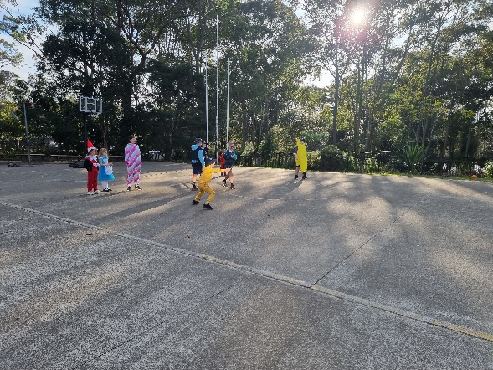
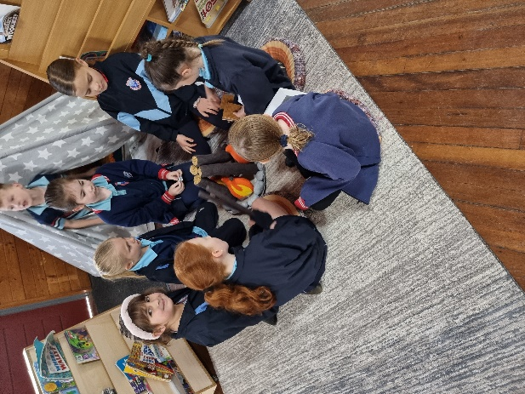
The Y OSHC
The Y NSW is one of the largest providers of OSHC in NSW.
Ensuring a safe environment for children and young people is our highest priority.
We are independently reviewed by the Australian Childhood Foundation (ACF) Safeguarding Children Program.
Our programs comply with National Quality Standard.

Slide 4






Why OSHC?
71% of children report a greater sense of belonging to their community from attending at the Y
66% of children reported they feel more confident in themselves
82% of children said they have friends at the Y
68% of children reported they have learnt something new at the Y
63% of children said they join in more physical activities when at the Y
77% of children said they feel happier to play, learn and have fun

Slide 5
Our Program
We provide resilient, resourceful and respectful environments where children can learn and thrive, have fun, feel safe, make friends and build confidence
We provide an engaging and varied program of activities, with a mix of creative, athletic and educational pursuits
Working in partnerships with families, our Educators consistently use the “My Time Our Place” principles, practices and learning outcomes to guide their planning and maximise each child's engagement in the program and opportunities for learning and development
The daily program consists of activities that cater to the different learning needs of the children, such as play-based learning, sensory and nature experiences, creative and cultural arts activities, outdoor sports, open-ended play and exploration
We listen to children’s voices and integrate their aspirations into our program planning.

Slide 6
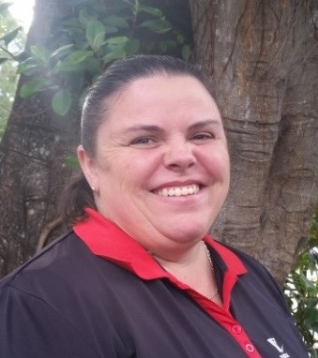
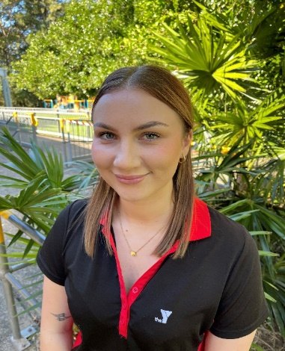
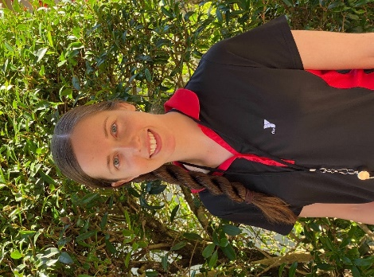
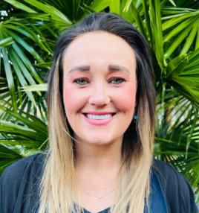
Our Team
In Centre
Each day, children and families will interact with our in centre teams, consisting a coordinator and educators.
Support Staff
We have a centralised enrolment team, as well as senior leadership team, who support our in centre teams and allow them to focus their attention on the children in attendance.
Safety & Training
All staff must undergo Working with Children check, criminal
history and reference checks prior to commencing, and
complete ongoing mandatory safeguarding children training.
Staff are also supported with ongoing professional
development and training.
Service Coordinator – Kate Ferrier
Educational Leader – Meg Williamson
Educators – Kara Cooper and Corrie Bryce

Slide 7

Kindy Children
The Y NSW will ensure Educators directly collect children from their classrooms in K block for afterschool care. For Before School Care, Kindergarten children are always walked to their class lines and released to a Wamberal Public Staff member. Any preferences regarding particular arrangements are discussed and worked out collaboratively.
Educators follow very clear policies and procedures in relation to effective supervision, dropping off and collection of children.
Watch this video to see how Ruby transitioned into big school and OSHC at the Y.
https://youtu.be/FZxD5vx0pTg

Slide 8
Our Fees
Before School Care
Prices start at
Casual Bookings - $21.50
Permanent Bookings - $19.50
After School Care
Casual Bookings - $30
Permanent Bookings - $28
Vacation Care
Prices start at
Casual bookings - $62
* Fees are subject to change
Childcare Subsidy
The Y NSW is an approved provider of the Child Care Subsidy for Out of School Hours Care (OSHC).
For eligible families enrolled in OSHC at the Y, the Child Care Subsidy (CCS) will assist with reducing the out of pocket child care costs and help to make child care more affordable.

Slide 9
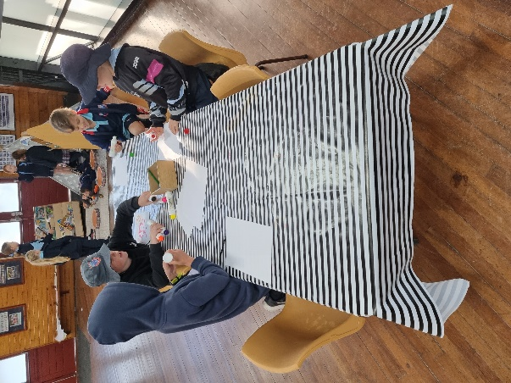
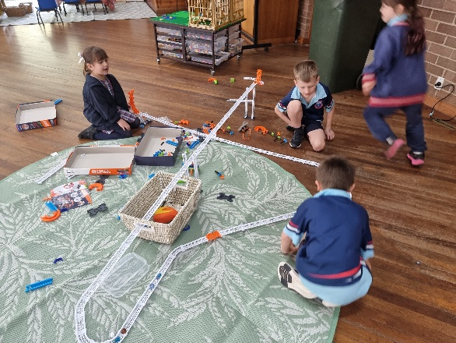
Programs
At the Y NSW, the individuality of each program is representative of the children that attend the service and Educational Leaders develop programs that are child-centred.
Our holistic approach recognises the differences children have in how they learn and develop, so we cater to age interests, designing spaces to meet developmental stages.
Through critical reflection, we modify experiences and activities to be relevant for each child. We build partnerships with families, schools and the wider community to develop confident lifelong learners.

Slide 10
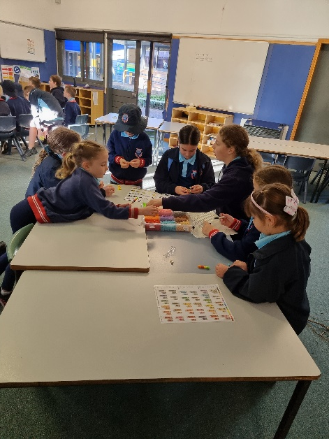
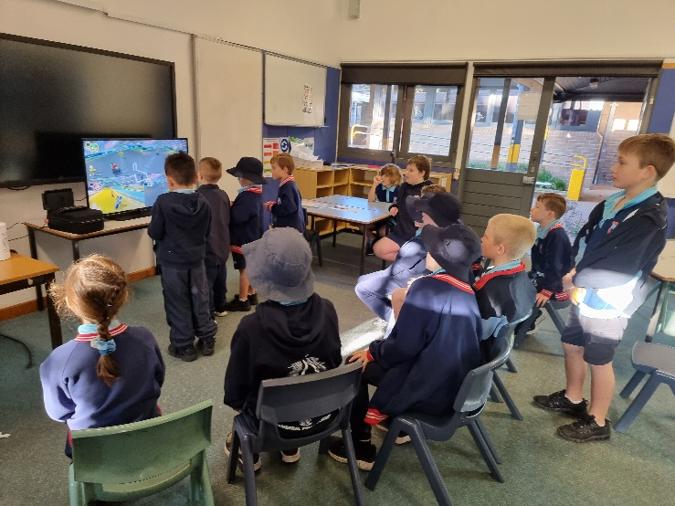
Before School Care
Before School Care: 7:00AM to 9:00AM
We help children get ready for the school day by running fun and engaging activities, such as:
  Mindfulness and relaxation, incorporating yoga
  Performing Arts - Drama, Dance and Music
  Science Experiments
We also serve a nutritious breakfast at no extra cost, such as:
  Cereal - Wheat Bix, Rice Bubbles, Sultana Bran, Corn Flakes
  Toast – with Butter, Jam, Vegemite, Cream Cheese
  Scrambled eggs
*Children with special dietary requirements are catered to through strict adherence to each of their requirements and special diets.

Slide 11
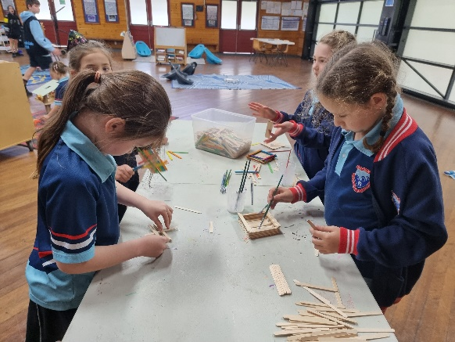
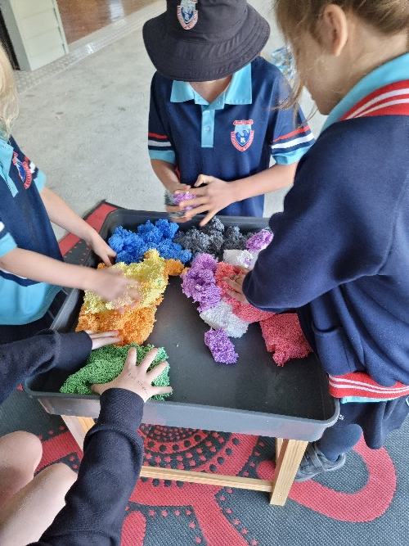
After School Care
After School Care: 3:30PM to 6:00PM
Once the school day is done, we help children wind down. We offer a mix of activities where children can socialise and broaden their horizons.
  Sustainability and Gardening
  Performing arts
  Visits from local community services
  Book Worms
  Y-Chef
We service a nutritious afternoon tea which includes:
  Home-made Pizza scrolls & muffins
  Fresh seasonal Fruit and Vege Platter
*Children with special dietary requirements are catered to through strict adherence to each of their requirements and special diets.

Slide 12
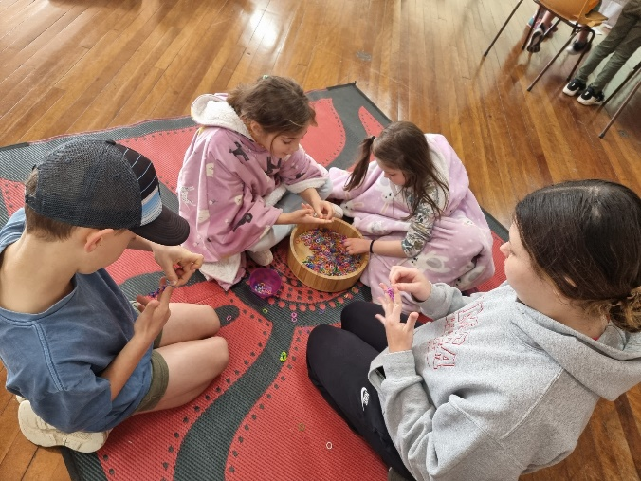
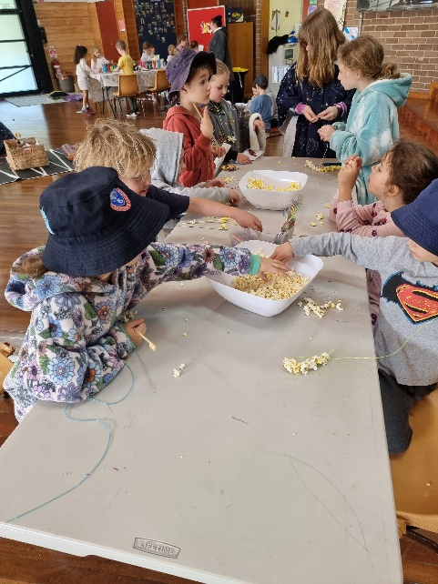
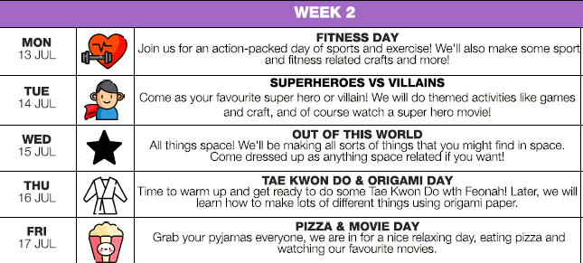
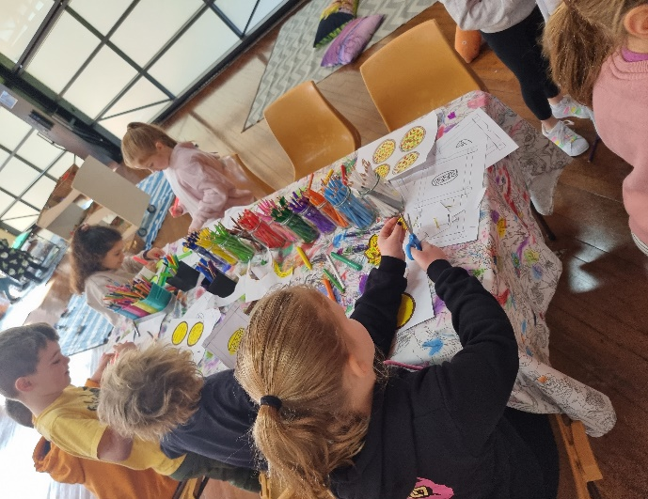
Vacation Care
Vacation Care: 7:00AM to 6:00PM
Our Vacation Care programs encourage children to be involved in a variety of fun and exciting activities and workshops.
Our programs include day camps, special guest visitors and exciting excursions!
*Program Example

Slide 13

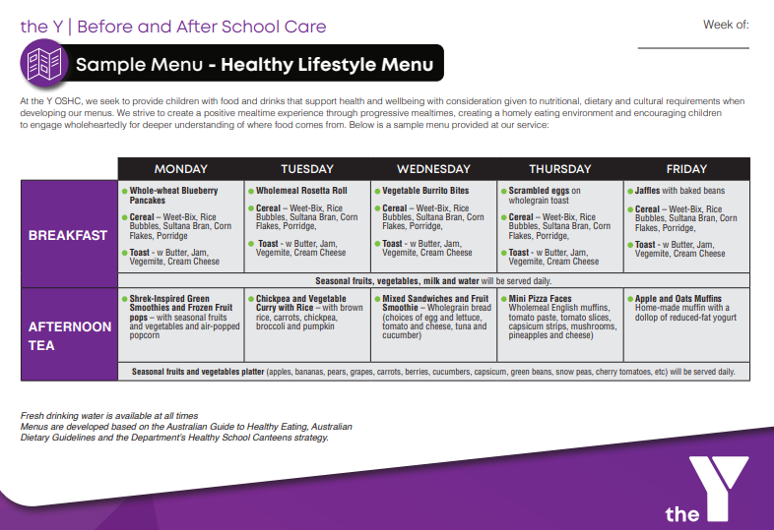
Before and After School Care
Sample Program

Slide 14


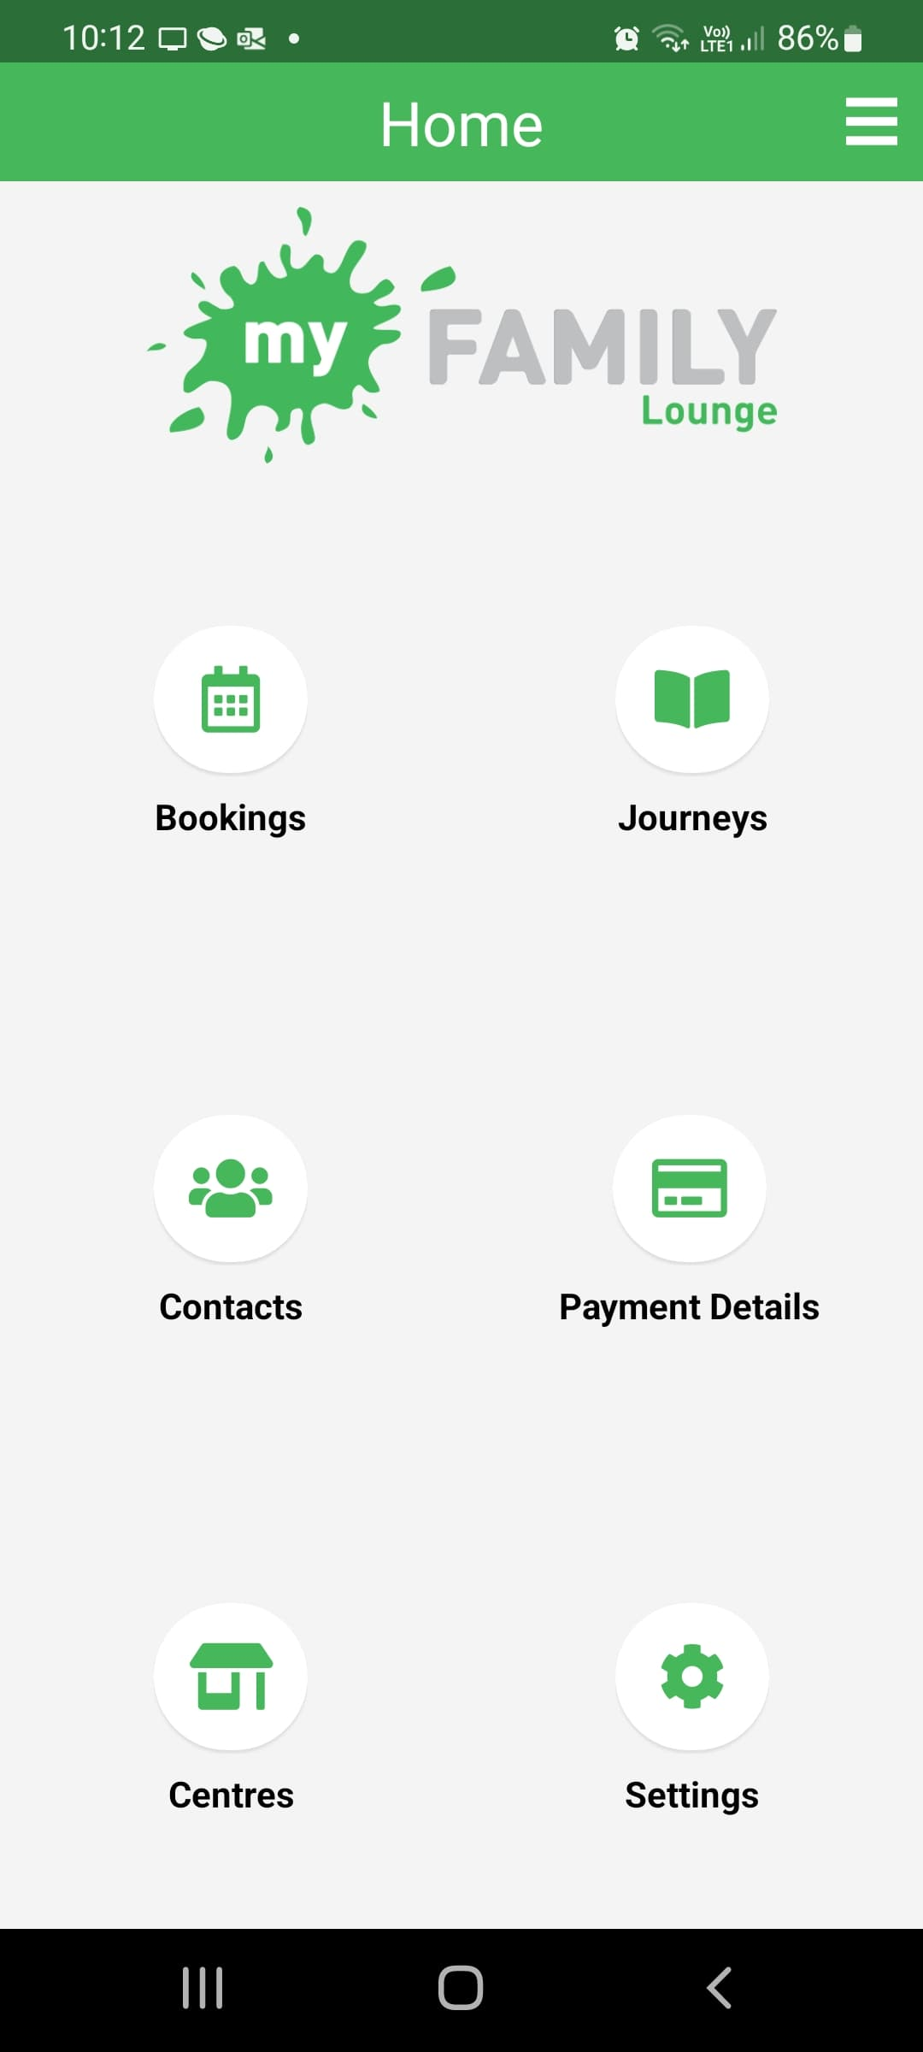
Enrolments
At the Y NSW OSHC, families can manage enrolments for
Before School, After School and Vacation Care through our
online booking platform, My Family Lounge.
Once enrolled, your online account gives you access to manage
your bookings in the palm of your hand, 24/7. You can:
View all existing bookings
make new casual bookings for BASC or Vacation Care
submit a waitlist request for a permanent booking
report absences
update your details
Submit your child’s details via our online enquiry form to get started!
https://www.ymcansw.org.au/childrens-services/enquiry/

Slide 15

Covid Safe
All of our Y OSHC Services implement COVID-19 Control Practices which aim to:
  Minimise the number of people becoming infected or sick with COVID-19
  Help you to manage your own risk and the risk to our children and families
  Provide clear and easy to follow practice in relation to operating the OSHC service during a pandemic
We are deeply committed to working together with all of our school communities and the Department of Education to ensure the best possible health outcomes for all.
Any changes to operations will continue to be communicated directly with affected families.

Slide 16
Questions?
Visit our website: https://www.ymcansw.org.au/childrens-services/
Email: childcare@ymcansw.org.au
Phone:
  For bookings & enrolments call the Childcare Team on 1300 009 679
  For enquiries specific to our service operations,
  call our service coordinator on 0400 813 789

