Slide 1
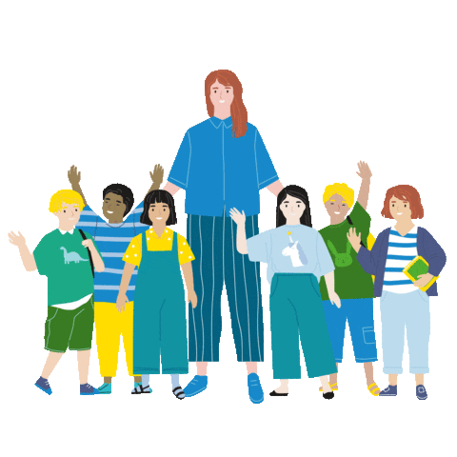
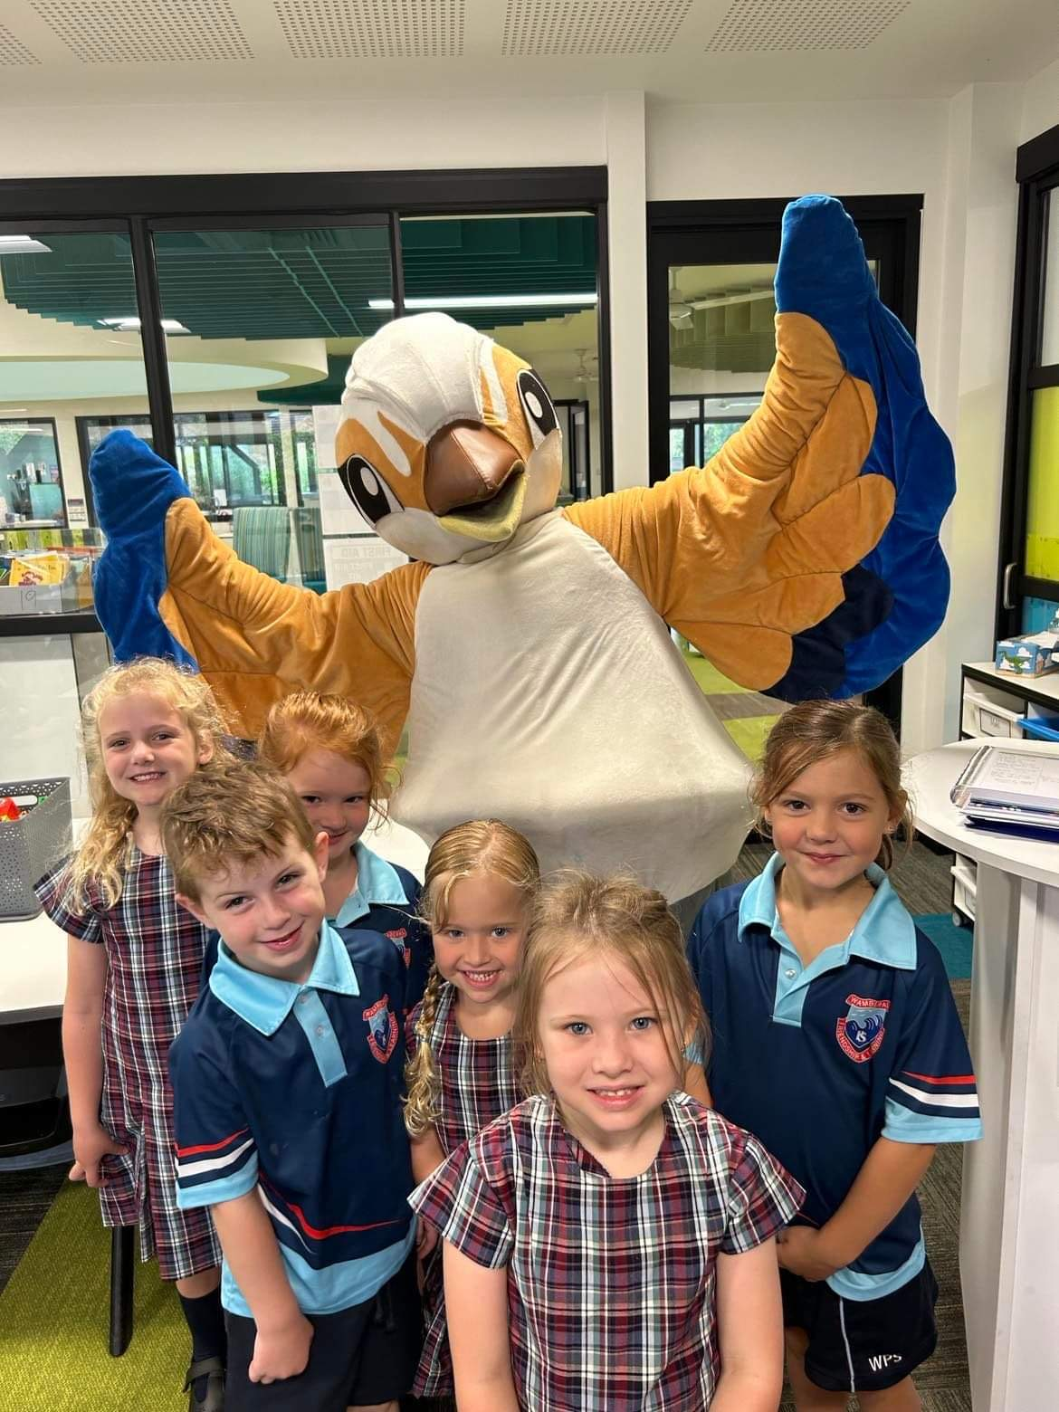
A Day In the life of A kindergarten Student
2024

Slide 2
Bell times
9.30am - School starts
3.30pm - Home time

Slide 3
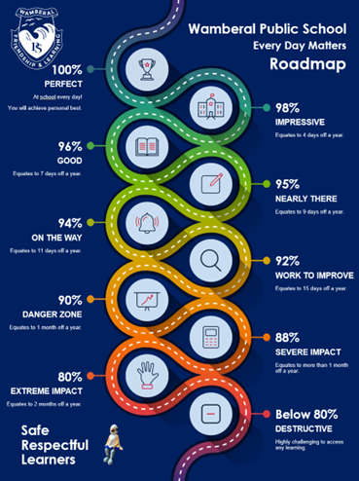
Attendance at school
Attendance Every Day Matters
Did you know students are expected to have above a 95% school attendance rate? Because days missed is years lost. That’s why making sure your child comes to school every single day, unless sick, is so important.

Slide 4
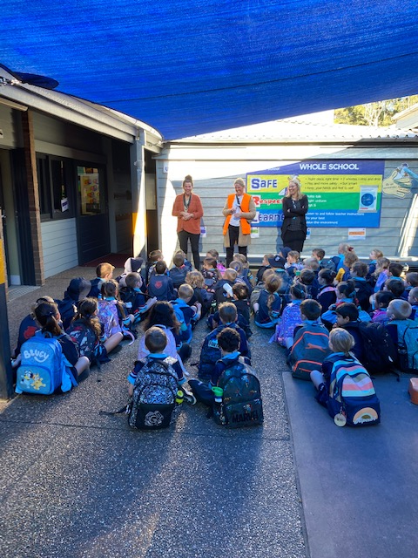
Lining up to go to class
Students will line up in their class lines and wait for their teachers when they hear the bell.

Slide 5
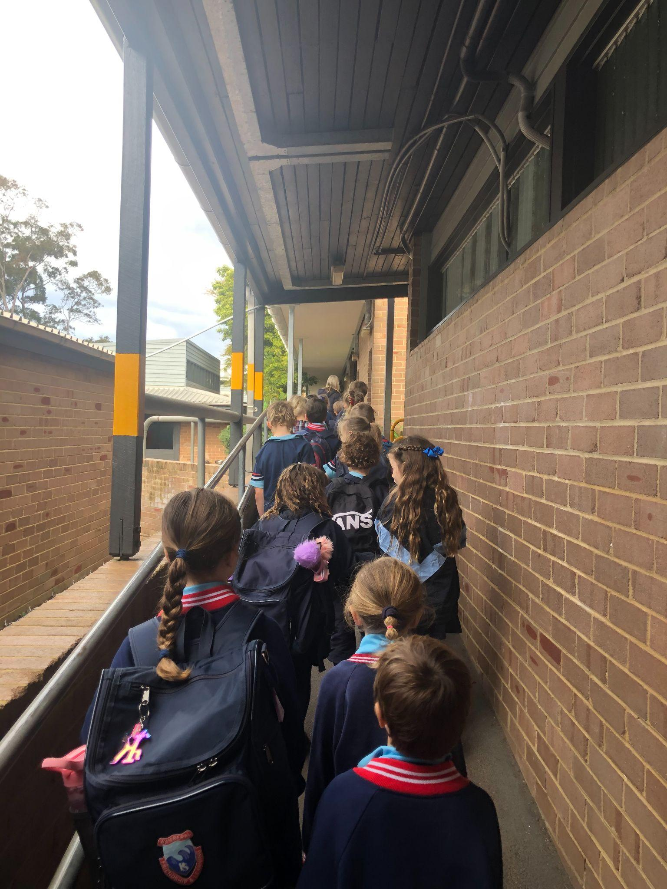
Walking to our classrooms
Students walk in their class lines to their classrooms.
We always encourage safe, responsible behaviour when walking around the school.

Slide 6
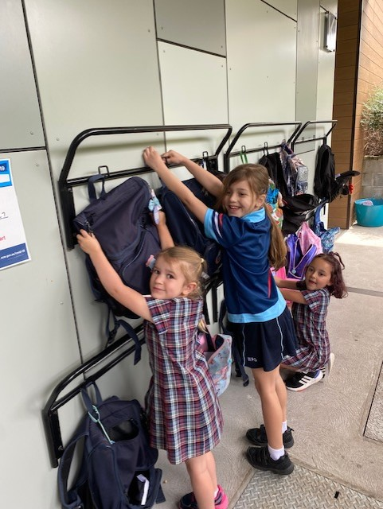
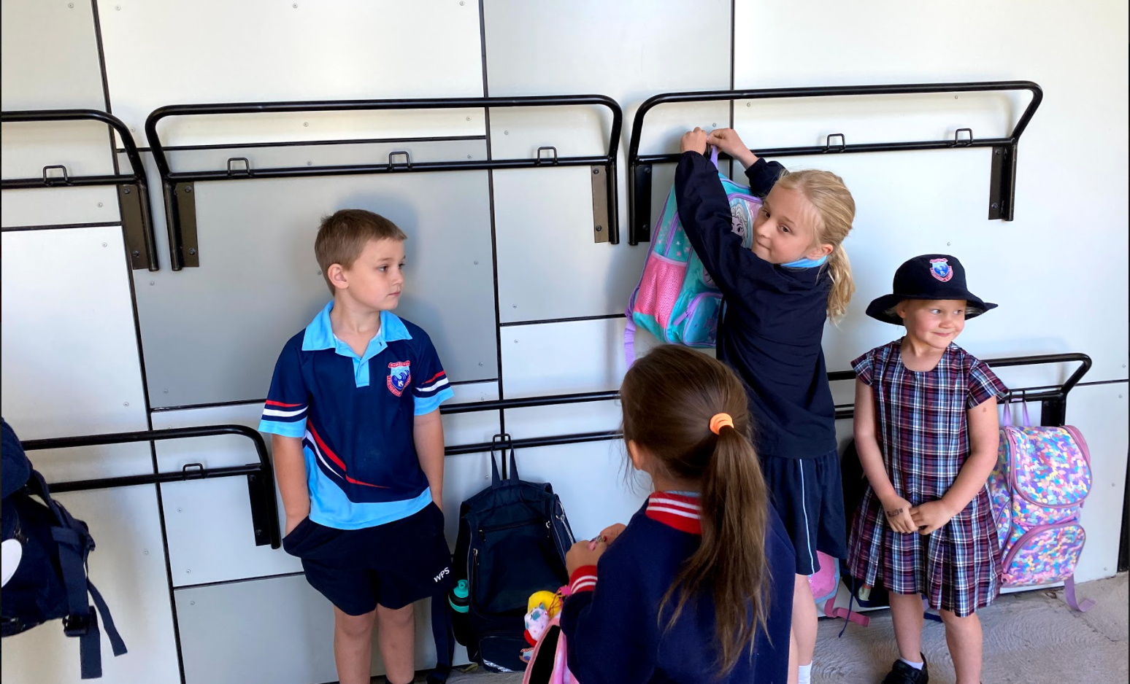
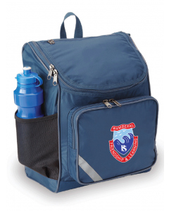
We will Hang Our Bags ON Hooks

Slide 7
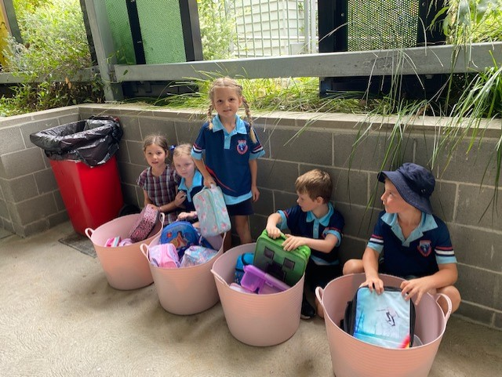
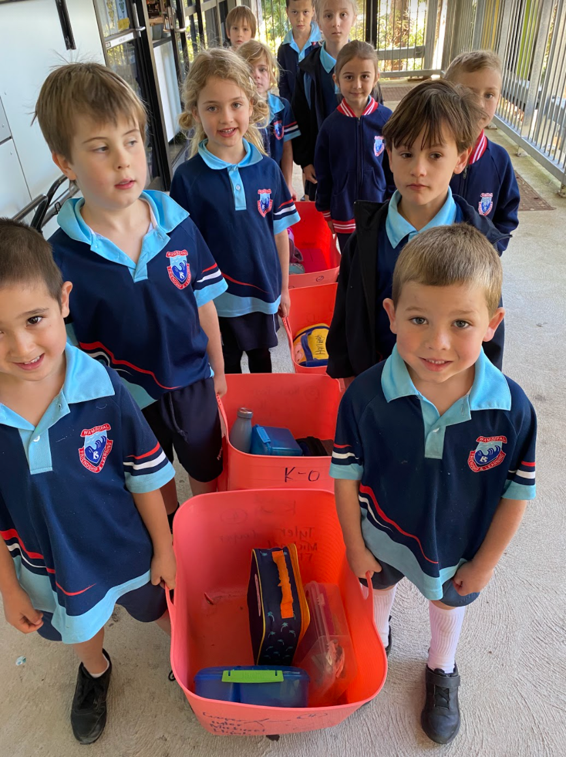
And we put our lunch boxes in here

Slide 8
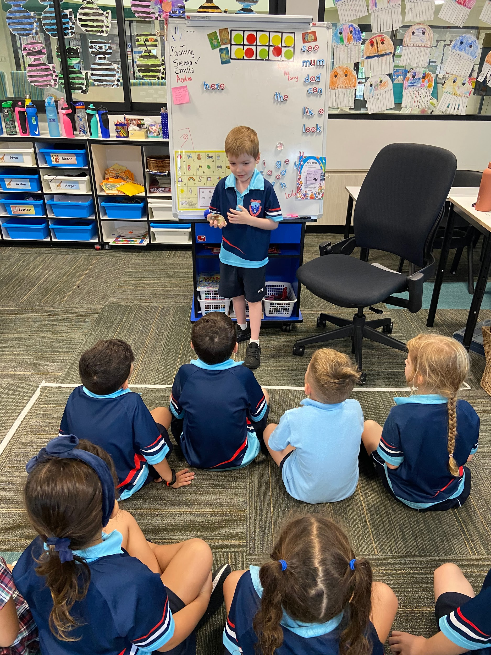
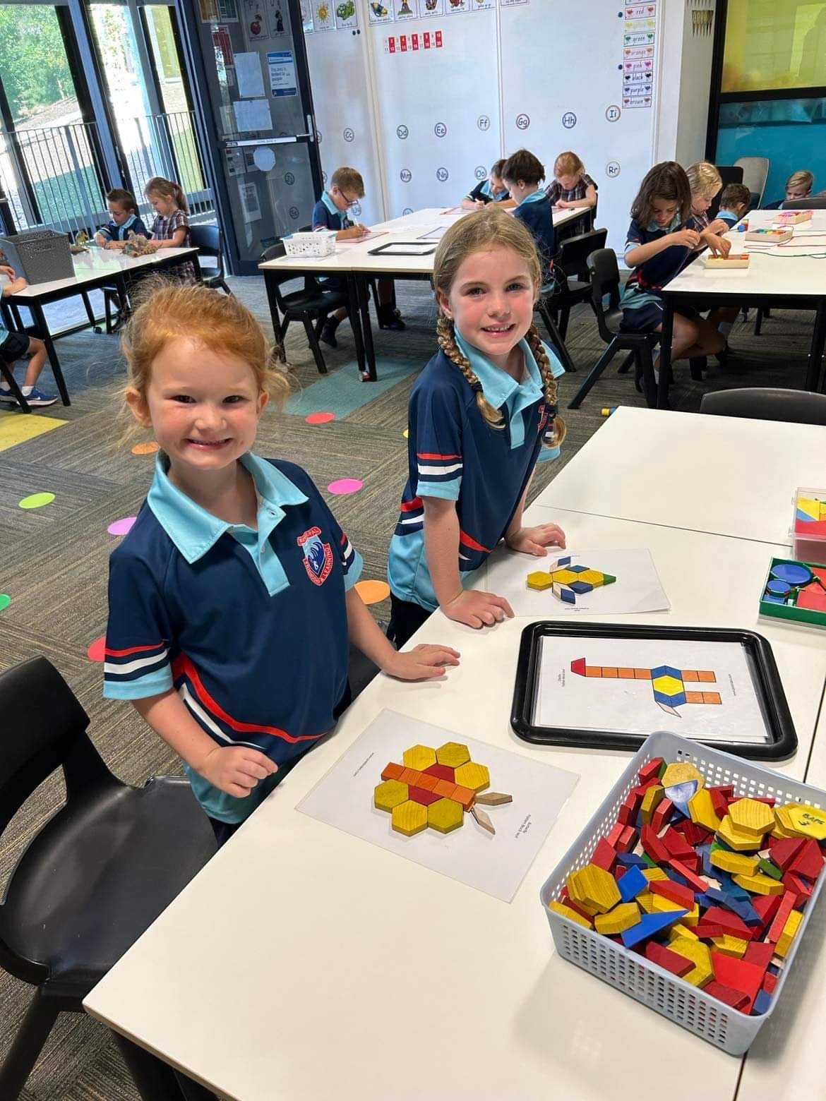
We sit on the floor for some activities or work at our desks

Slide 9
Literacy Groups
Reading
Writing
Speaking and Listening
We start the day with english:

Slide 10
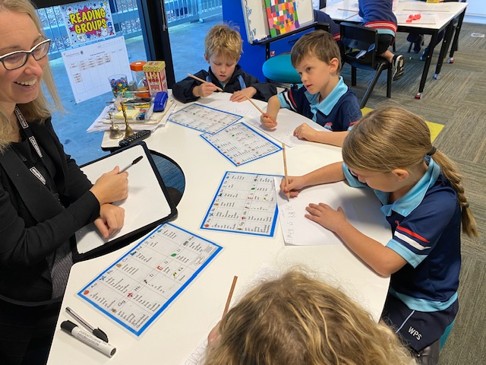
Reading and Writing with the teacher

Slide 11
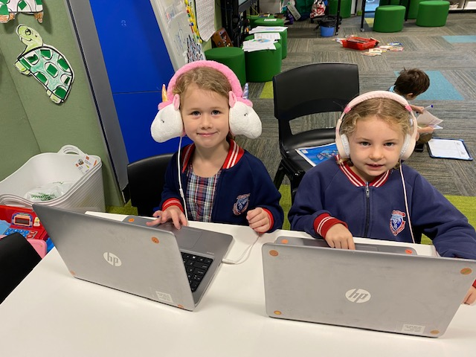
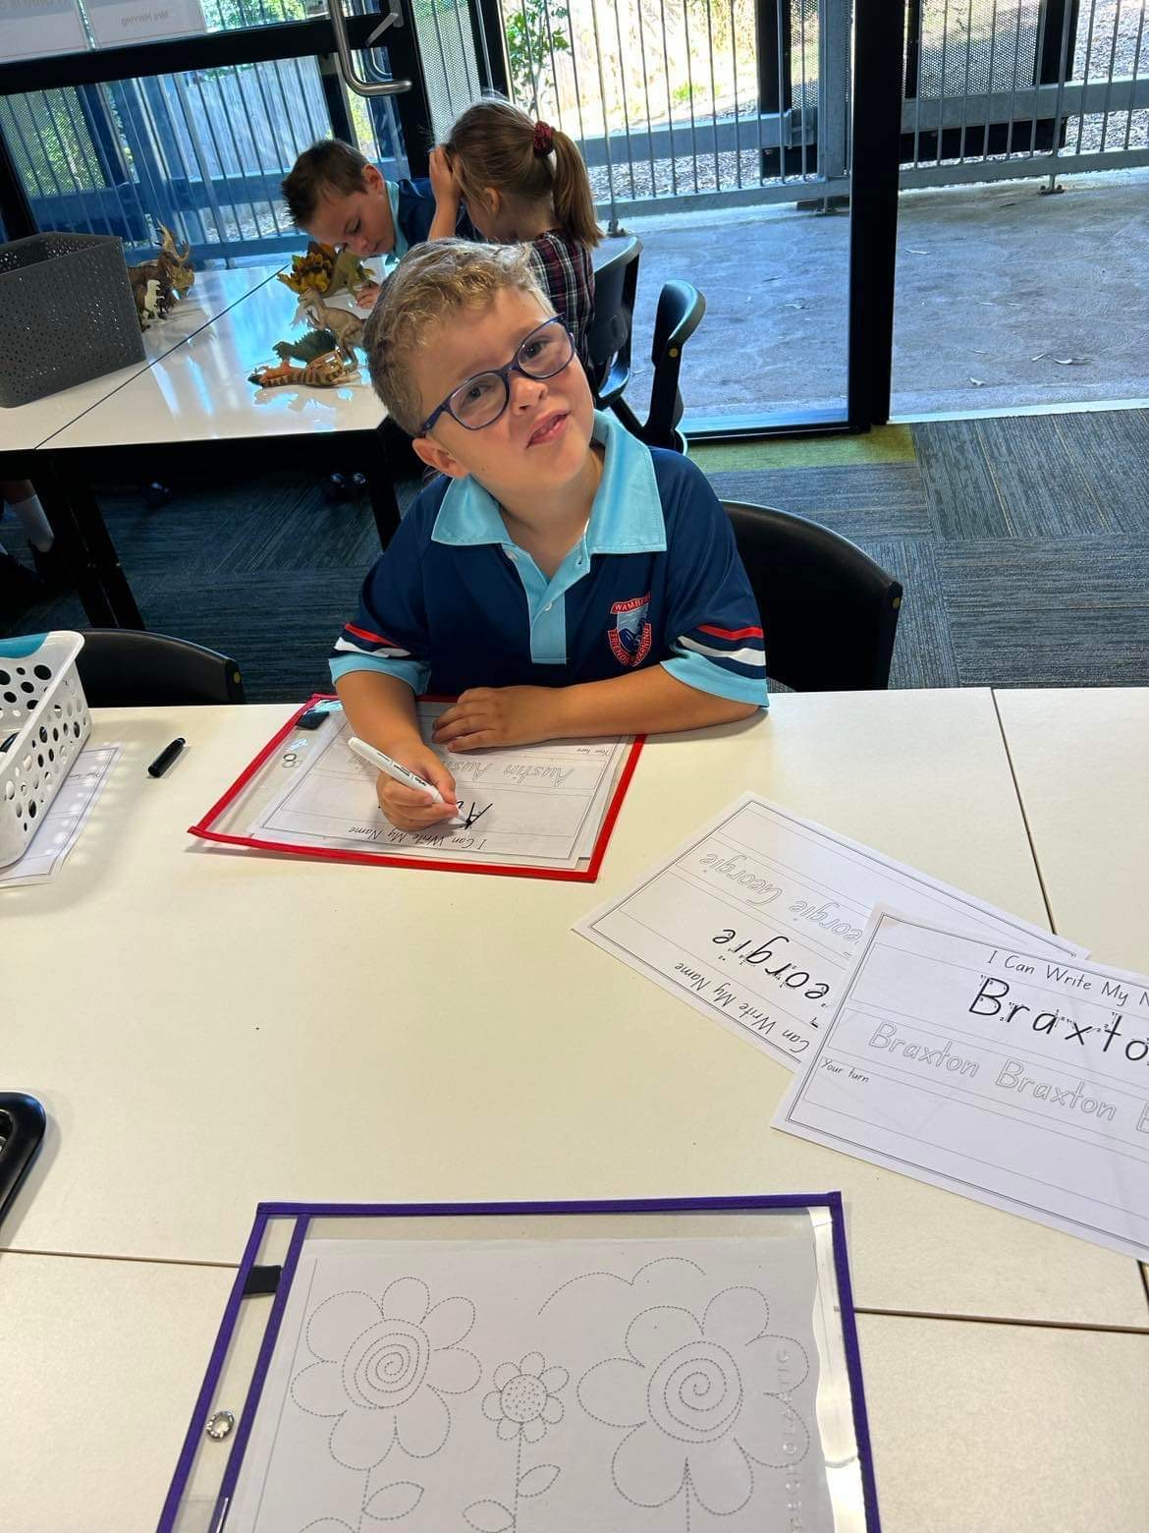
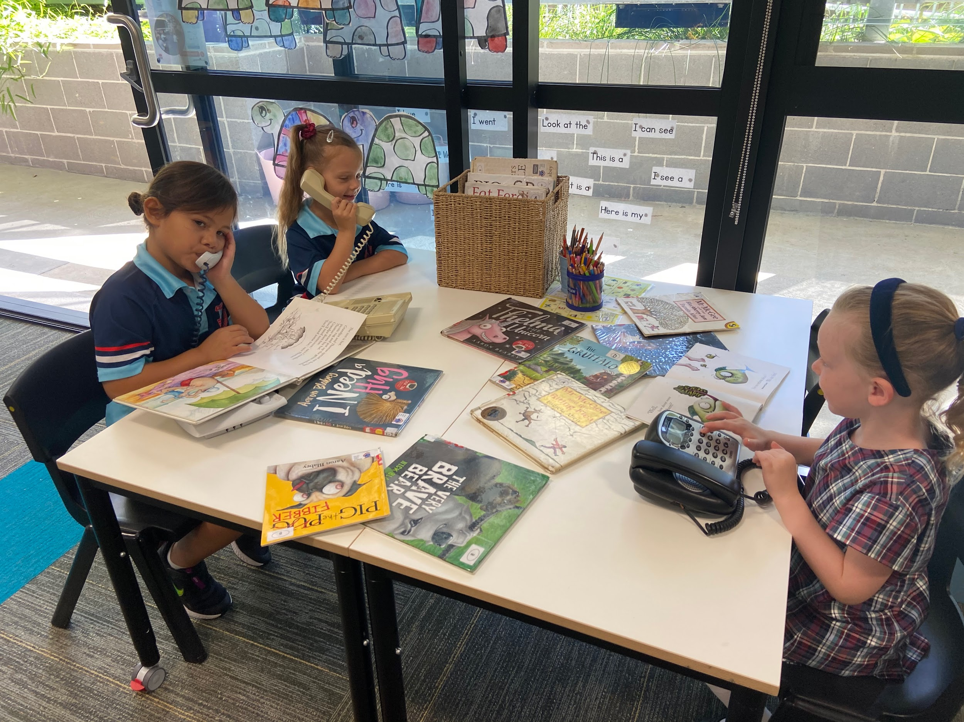
Literacy activities:
Each day we do lots of fun literacy activities

Slide 12
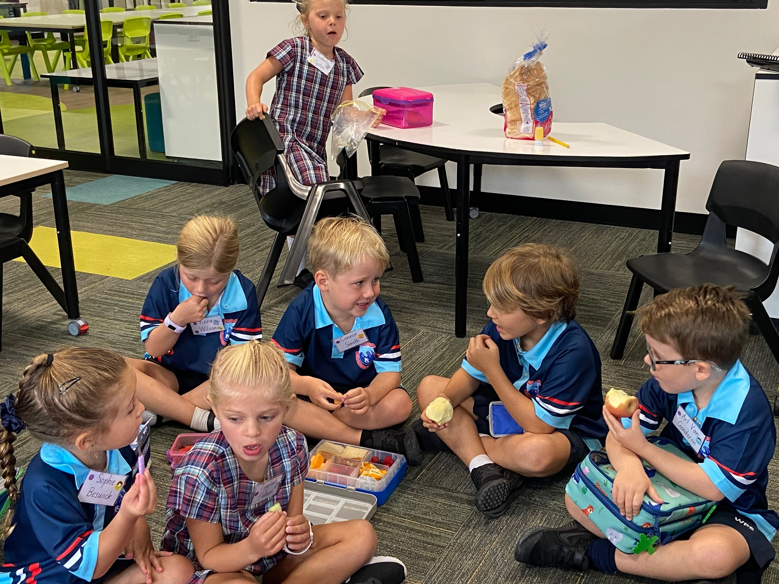
Fruit break:
During the morning session we have a quick fruit break to refuel our brains, ready for more learning

Slide 13
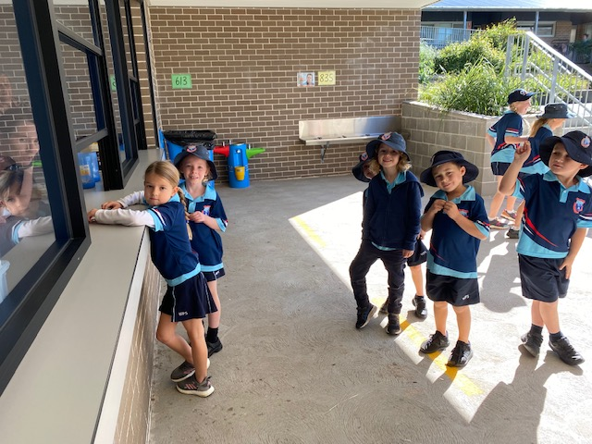
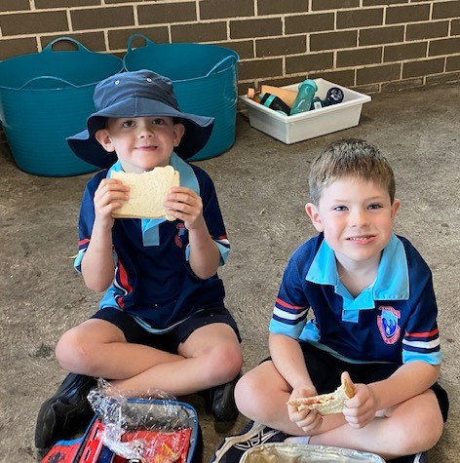
Break times:
Students have eating time before play time. We encourage them to eat their lunchbox food before going to the canteen.
Remember…
11.35am - lunch time
1.35pm - recess time

Slide 14
Maths
After lunch we usually do Maths. Sometimes it is with the whole class and sometimes it is group work.

Slide 15
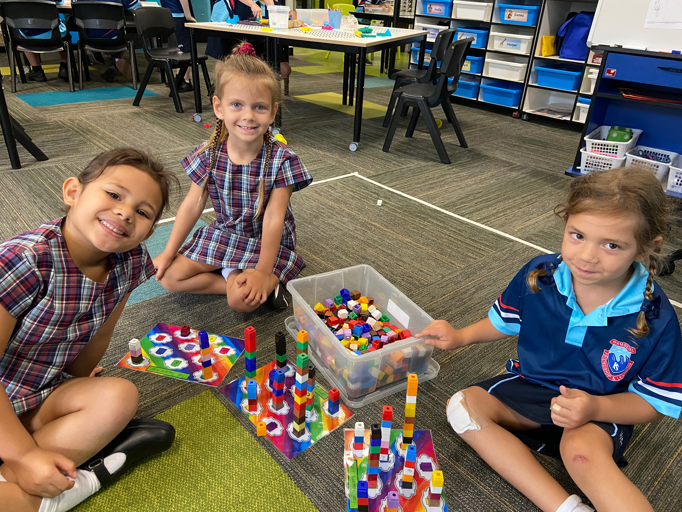
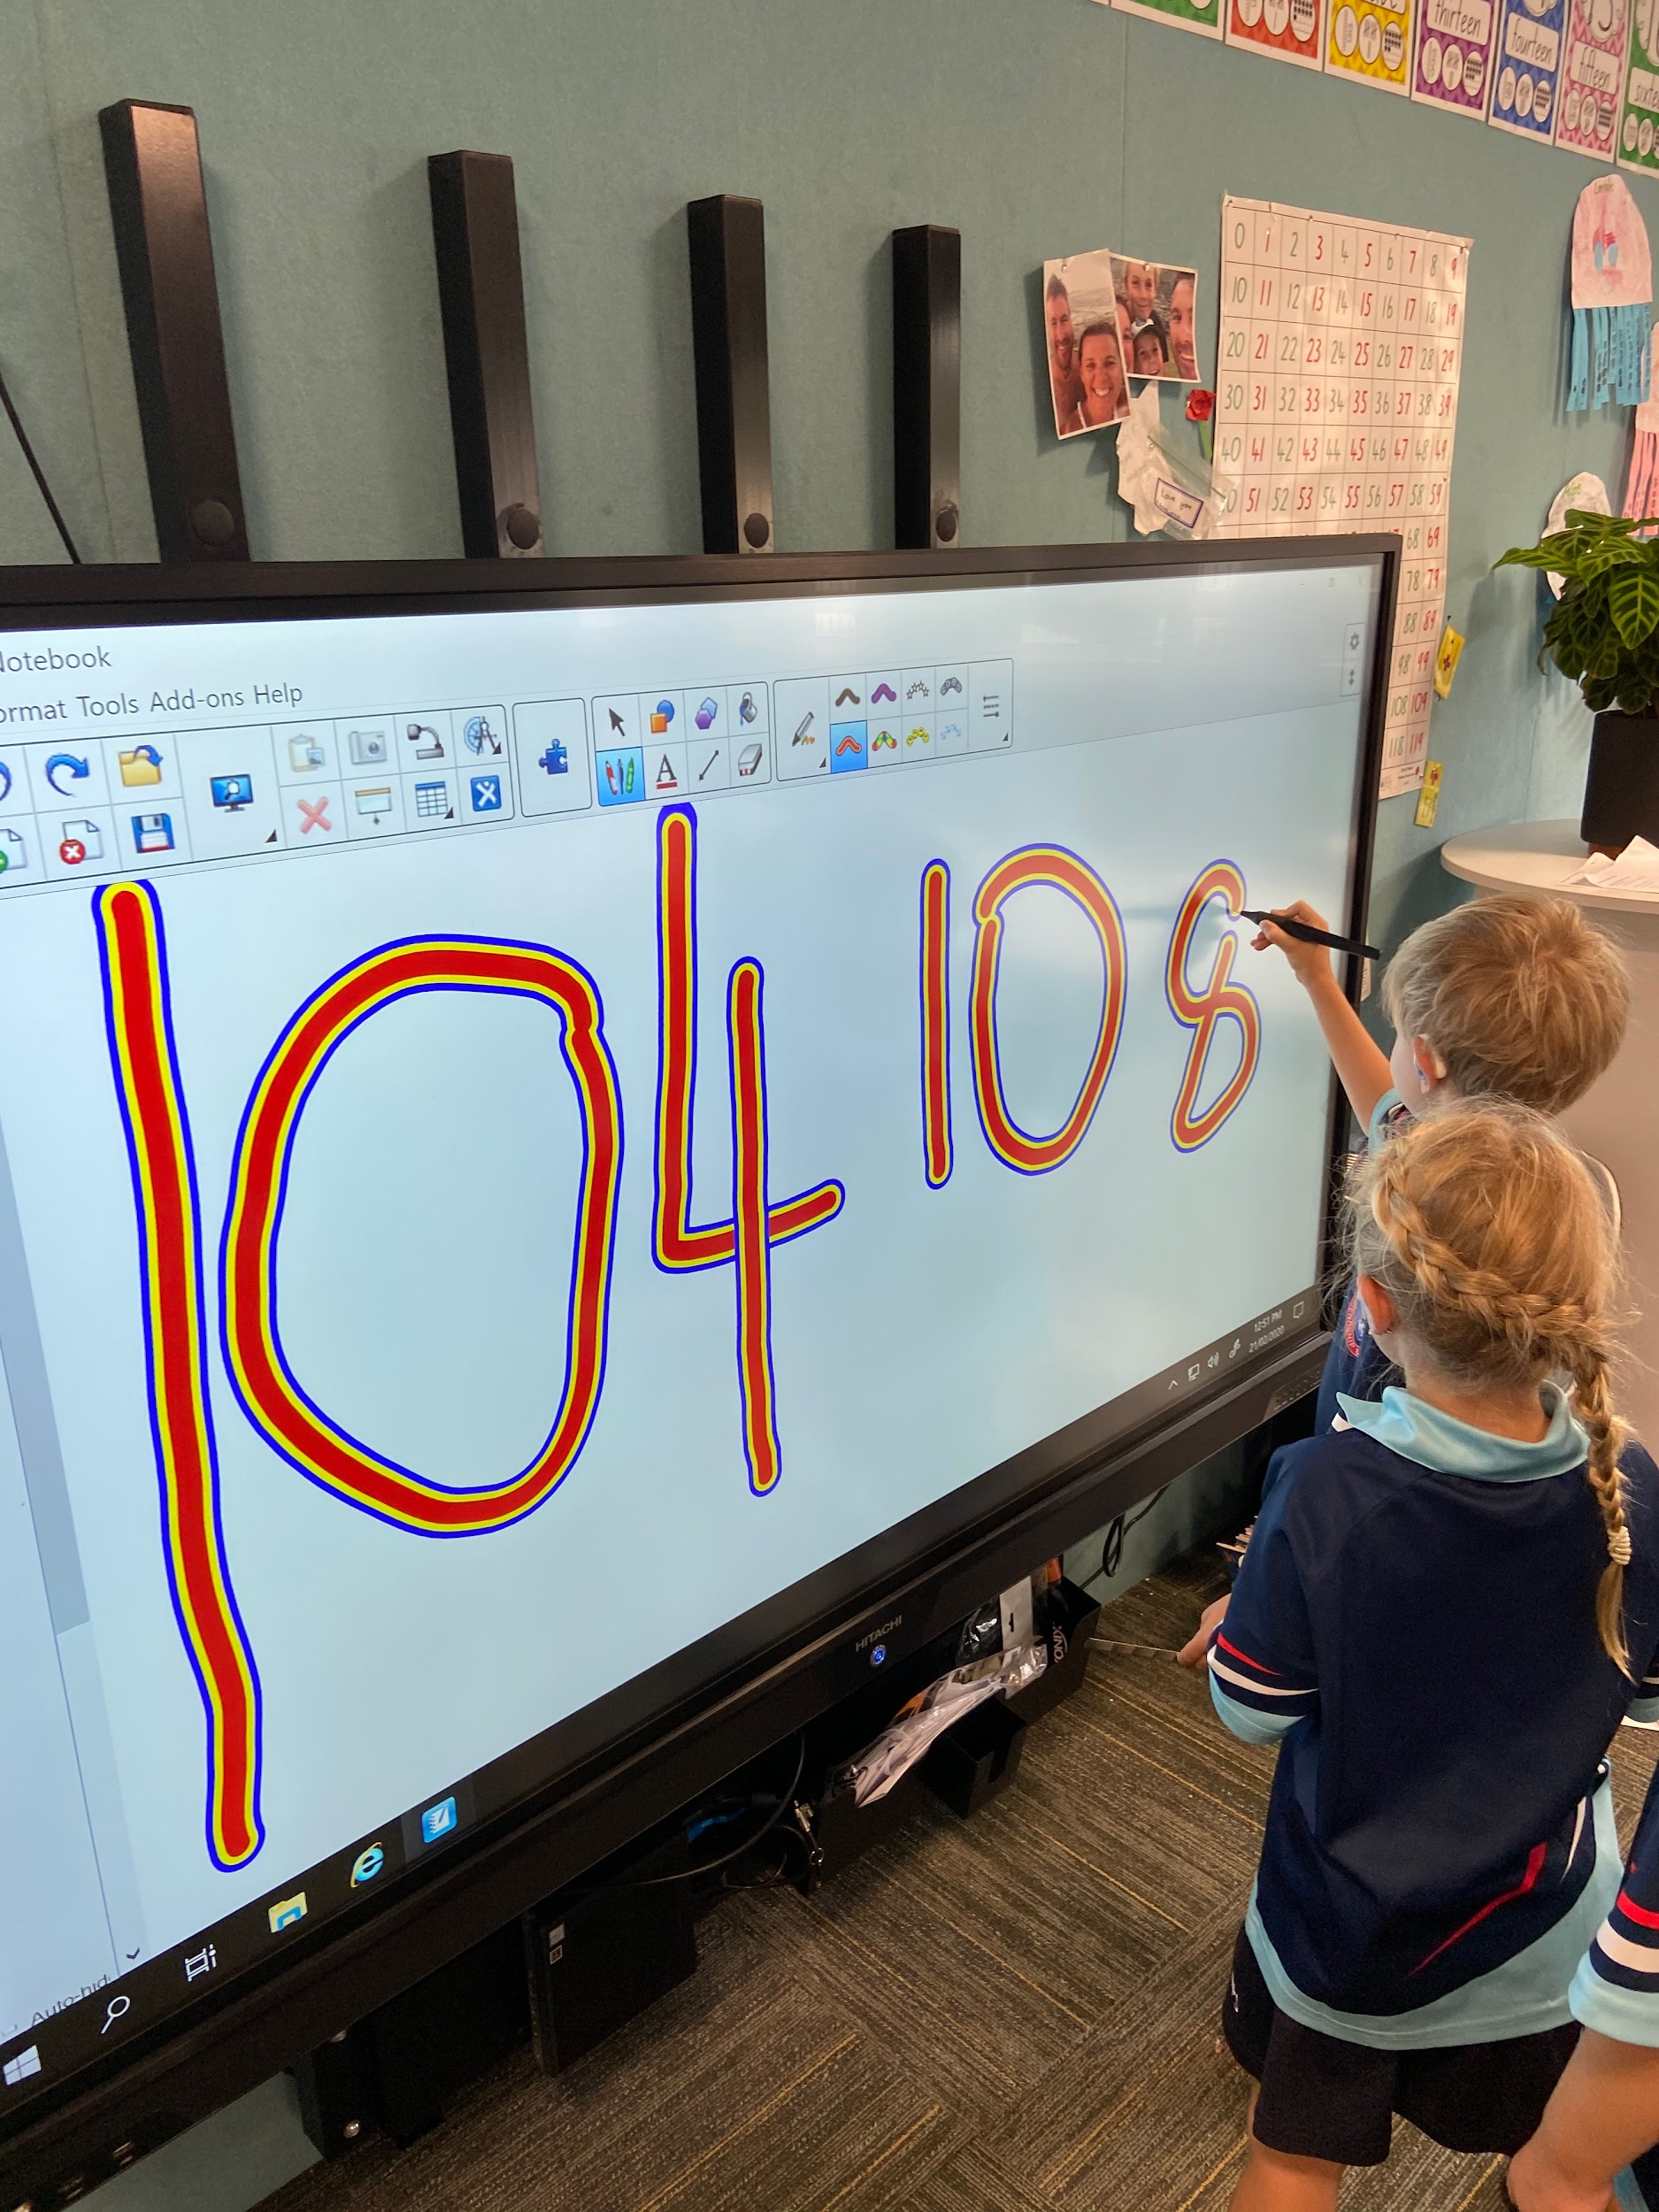
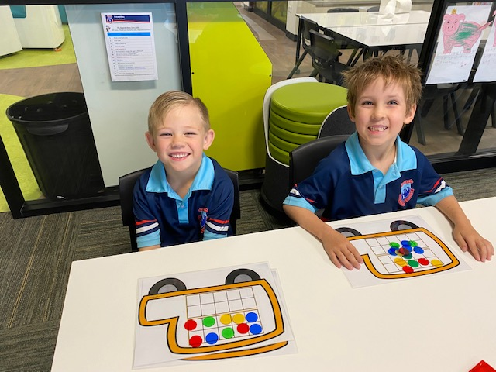
We learn Maths in lots of different ways...

Slide 16
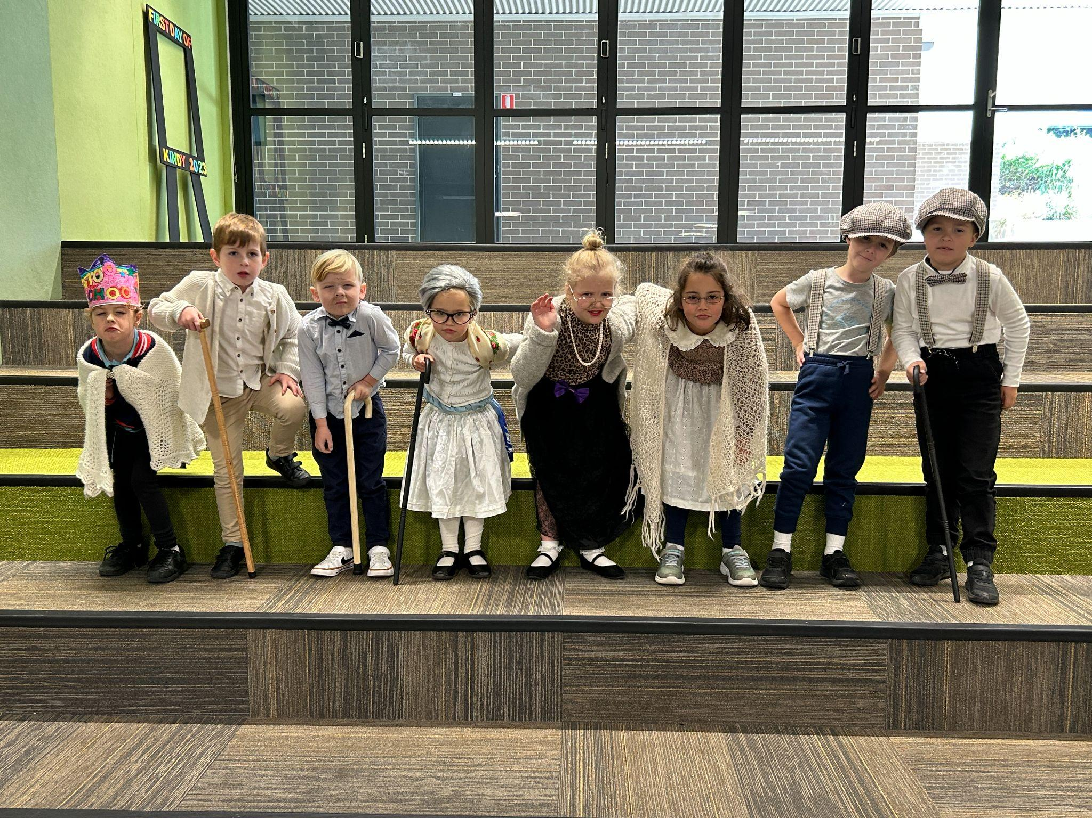
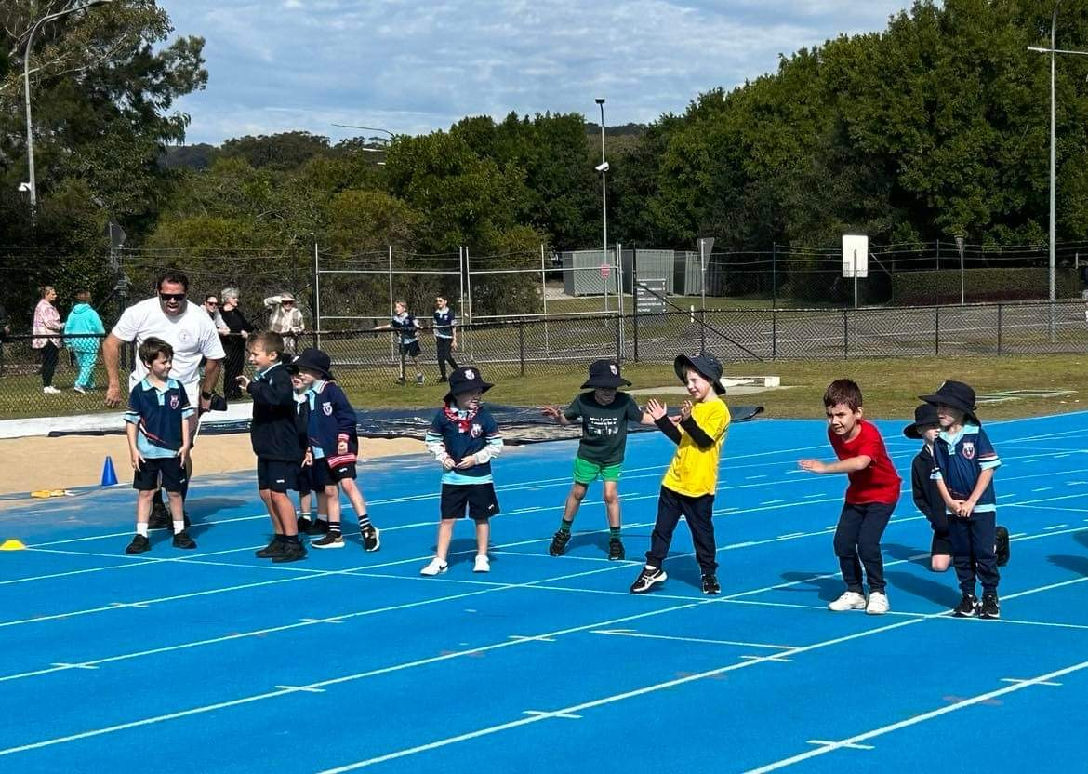
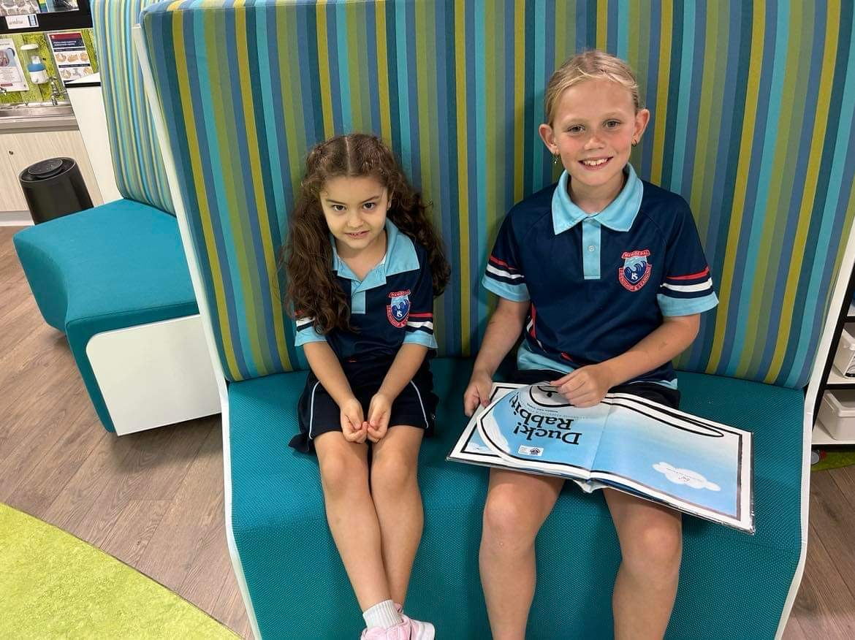
Other Key learning areas:
In Kindergarten we also do Science, Geography, Creative Arts and PD.H.PE. Students get the opportunity to be involved in excursions and other onsite learning experiences.

Slide 17
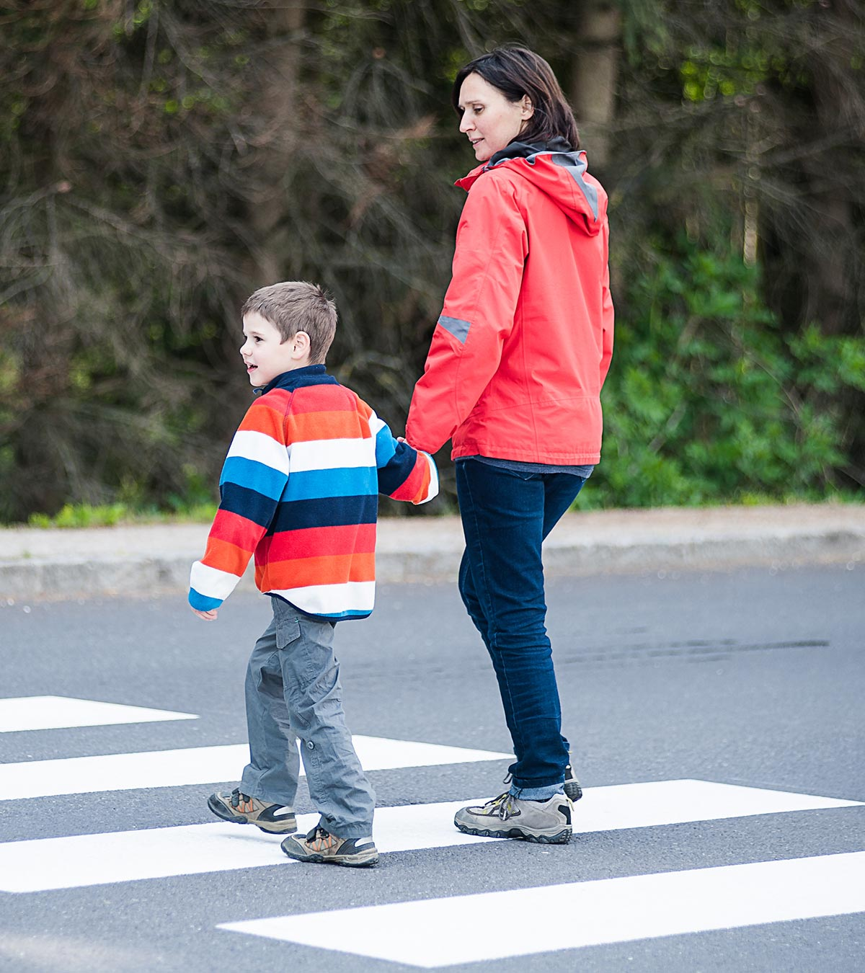
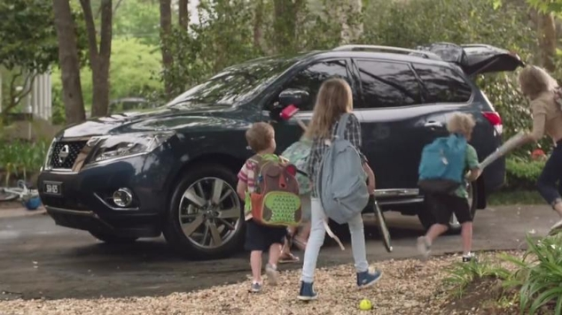
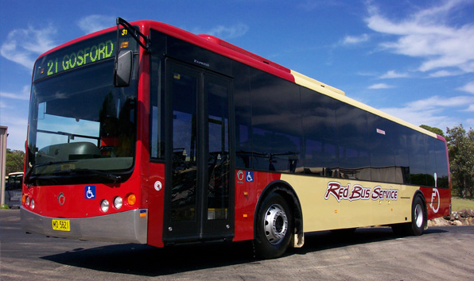
Home time:
There are lots of different ways for students to go home. Talk to your child about their routine so they know where to go.
Pick up | Bus | YMCA | Walkers

Slide 18
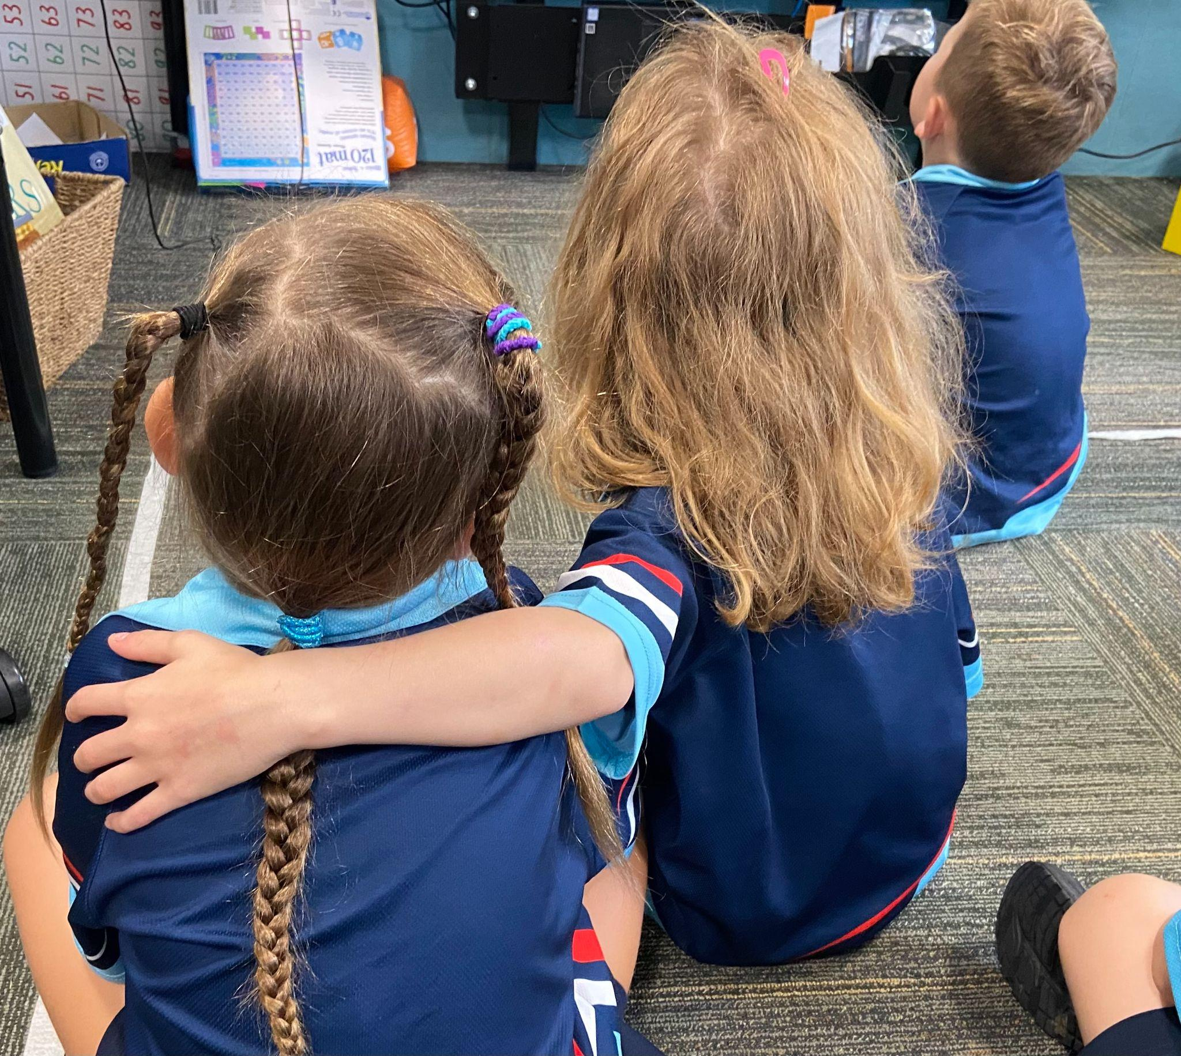
Kindergarten is exciting and you learn so much!

